Slide 1


Introducing the River Basin Export Reduction Optimization Support Tool (RBEROST)
Catherine Chamberlin¹, Marilyn ten Brink², Naomi Detenbeck²
¹ ORISE – EPA, ORD/CEMM, Atlantic Coastal Environmental Sciences Division, Narragansett, RI
² ORD/CEMM, Atlantic Coastal Environmental Sciences Division, EPA, Narragansett, RI
USEPA R User Group Workshop 2021
1

Slide 2
Outline:
Purpose and goals of the River Basin Export Reduction Optimization Support Tool (RBEROST)
Mathematical optimization
Software structure of the tool
Using R and Shiny for a clean user interface
Lessons learned
Future directions
2

Slide 3

Problem:
Purpose and goals of the River Basin Export Reduction Optimization Support Tool (RBEROST)
3

Slide 4
Goal:
Develop and a regional optimization tool to allow stakeholders to find the least-cost solution to meet nutrient loading targets
Purpose and goals of the River Basin Export Reduction Optimization Support Tool (RBEROST)
4

Slide 5
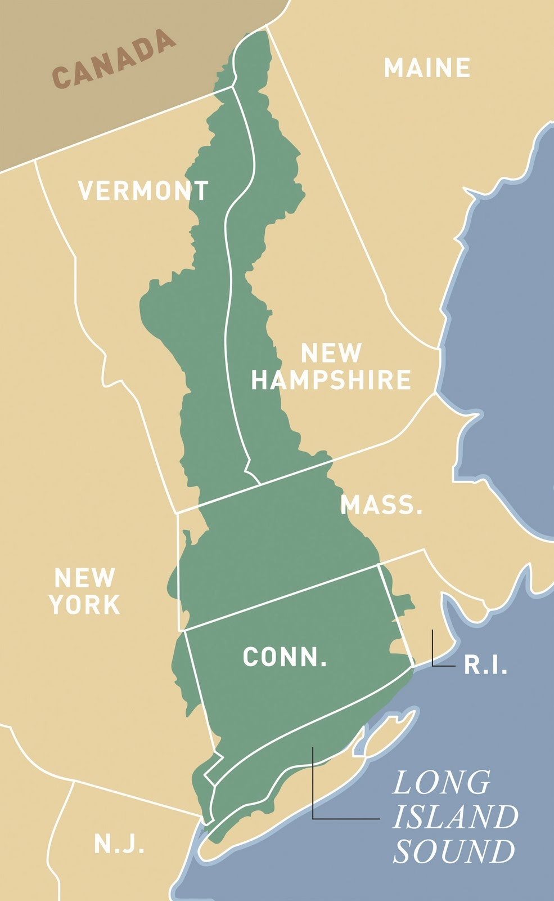
Illustrative Case Study:
The tool developed for this case study needs to be extensible to a larger region
Tool should be built on national and regional datasets
Photo Credit: The Long Island Sound Study
Purpose and goals of the River Basin Export Reduction Optimization Support Tool (RBEROST)
5

Slide 6
Necessary tool properties:
The tool developed for this case study needs to be extensible to a larger region
Tool should be built on national and regional datasets
~ 16,000 km²;
need a tool that can optimize large spatial scales without extensive computational resources
Photo Credit: The Long Island Sound Study
Purpose and goals of the River Basin Export Reduction Optimization Support Tool (RBEROST)
6

Slide 7
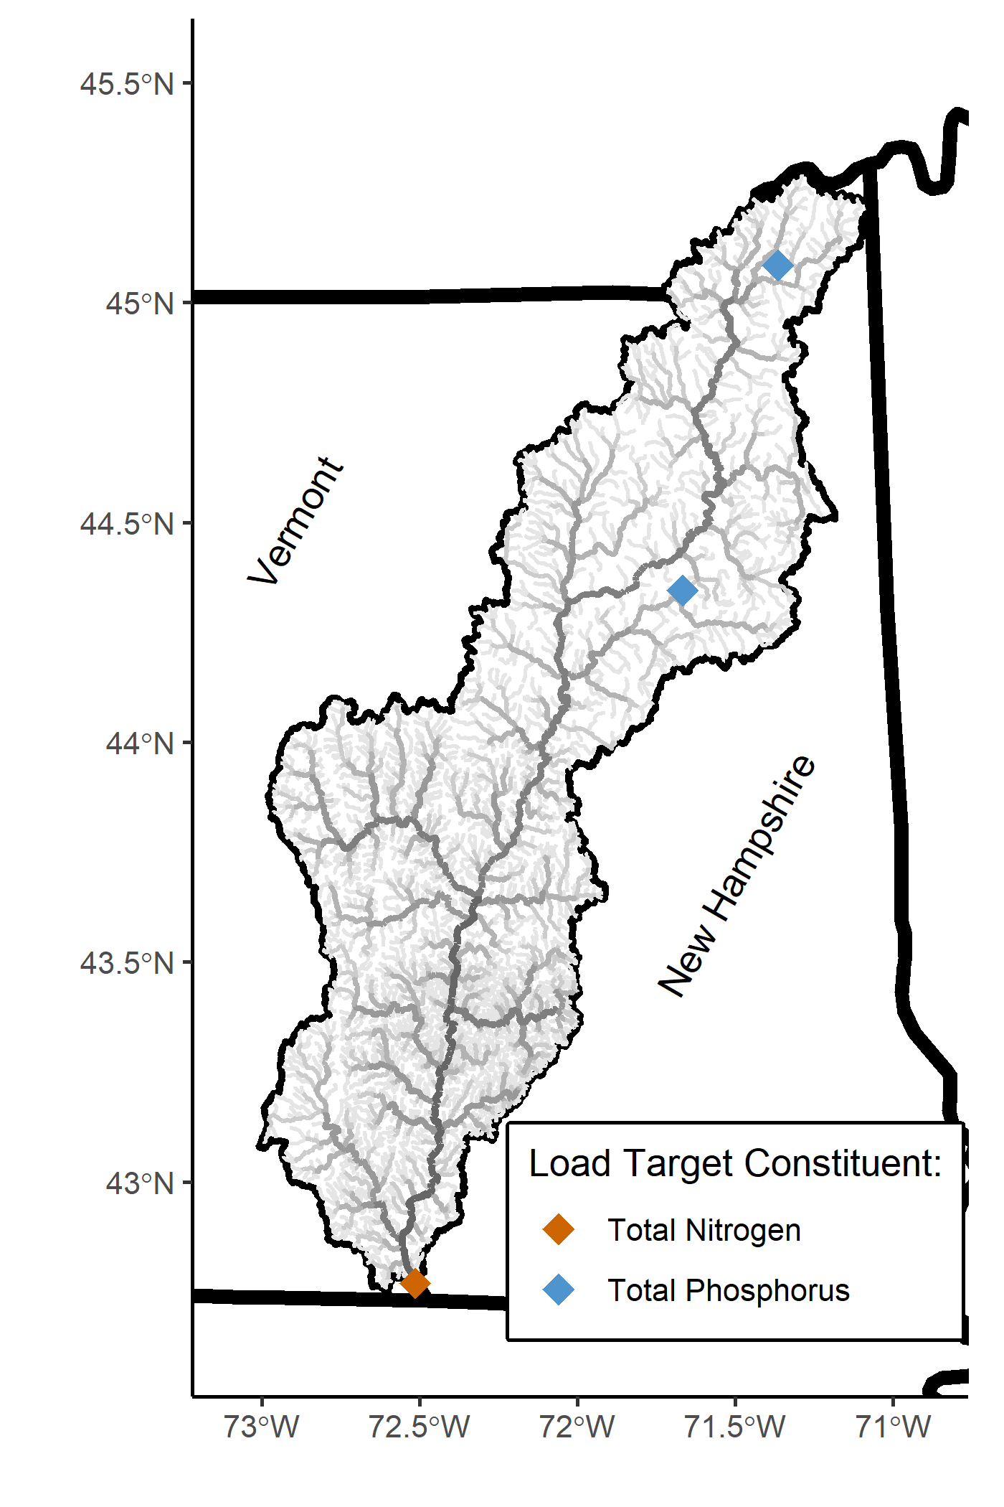
Necessary tool properties:
The tool developed for this case study needs to be extensible to a larger region
Tool should be built on national and regional datasets
~ 16,000 km²;
Tool should be able to optimize large spatial scales without extensive computational resources
Both Total Nitrogen and Total Phosphorus contribute to water quality issues
Tool should be able to optimize for loads of multiple constituents at one.
Purpose and goals of the River Basin Export Reduction Optimization Support Tool (RBEROST)
7

Slide 8
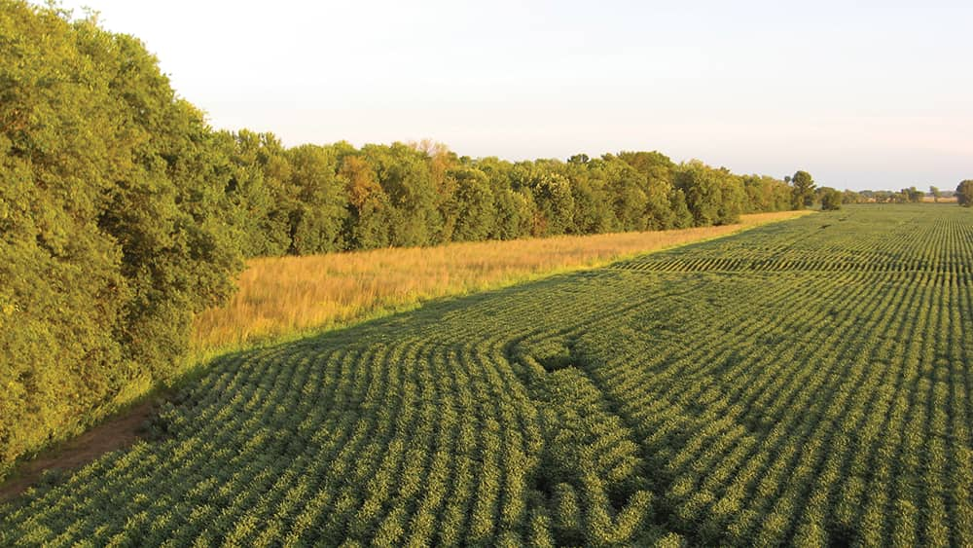
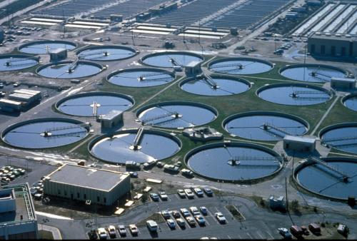
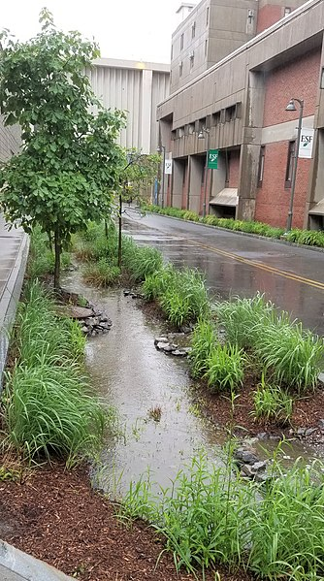

Necessary tool properties:
The tool developed for this case study needs to be extensible to a larger region
Tool should be built on national and regional datasets
~ 16,000 km²;
Tool should be able to optimize large spatial scales without extensive computational resources
Both Total Nitrogen and Total Phosphorus contribute to water quality issues
Tool should be able to optimize for loads of multiple constituents at one.
Treatments exist for diverse point and non-point sources
Tool should consider treatments for nutrients from both point and non-point sources from a variety of land use types.
Photo Credit: Iowa Agriculture Water Alliance
Photo Credit: eutrophication&hypoxia (Flickr)
Photo Credit: Tony Webster (Flickr)
Photo Credit: DASonnenfeld (Wikimedia)
Purpose and goals of the River Basin Export Reduction Optimization Support Tool (RBEROST)
8

Slide 9
Necessary tool properties:
The tool developed for this case study needs to be extensible to a larger region
Tool should be built on national and regional datasets
~ 16,000 km²;
Tool should be able to optimize large spatial scales without extensive computational resources
Both Total Nitrogen and Total Phosphorus contribute to water quality issues
Tool should be able to optimize for loads of multiple constituents at one.
Treatments exist for diverse point and non-point sources
Tool should consider treatments for nutrients from both point and non-point sources from a variety of land use types.
Potential tool users have a wide variety of backgrounds and experiences.
Tool should not require knowledge or expertise in code and should have a user-friendly interaction.
Purpose and goals of the River Basin Export Reduction Optimization Support Tool (RBEROST)
9

Slide 10
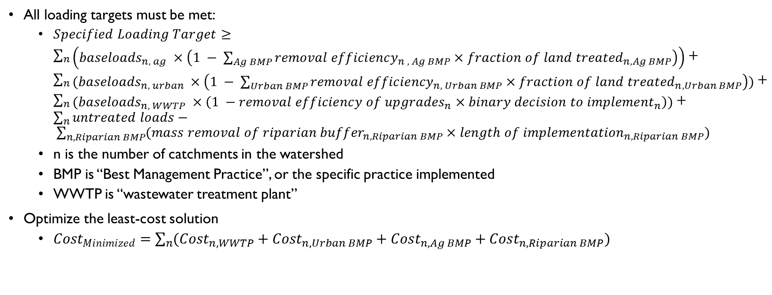
Mathematical Optimization:
All loading targets must be met:
$Specified Loading Target≥\sum_{n}{\begin{aligned} \\ \left({baseloads}_{n, ag} ×\left(1 − \sum_{Ag BMP}{{removal efficiency}_{n , Ag BMP}×{fraction of land treated}_{n, Ag BMP}}\right)\right)\end{aligned}}+\sum_{n}{\begin{aligned} \\ ({baseloads}_{n, urban} ×\left(1 − \sum_{Urban BMP}{{removal efficiency}_{n, Urban BMP}×{fraction of land treated}_{n, Urban BMP}}\right))\end{aligned}}+\sum_{n}{\begin{aligned} \\ ({baseloads}_{n, WWTP} ×\left(1 −{removal efficiency of upgrades}_{n}×{binary decision to implement}_{n}\right))\end{aligned}}+\sum_{n}{untreated loads}− \sum_{n, Riparian BMP}{({mass removal of riparian buffer}_{n, Riparian BMP}×{length of implementation}_{n, Riparian BMP})}$
n is the number of catchments in the watershed
BMP is “Best Management Practice”, or the specific practice implemented
WWTP is “wastewater treatment plant”
Optimize the least-cost solution
$Cost_{Minimized}=\sum_{n}{(Cost_{n, WWTP}+Cost_{n, Urban BMP}+Cost_{n, Ag BMP}+Cost_{n, Riparian BMP})}$
Mathematical Optimization
10

Slide 11
Optimization in A Mathematical Programming Language (AMPL):
Linear mixed-integer optimization
Make use of free community solvers hosted on a web server
AMPL Data File
Legend:
Data
Optimization Support File
User Input/Interaction
Result
Model
AMPL Model File
AMPL Command File
Optimization Solver (CPLEX)
Best Management Practice (BMP) selection at minimized cost
Software structure of the tool
11

Slide 12
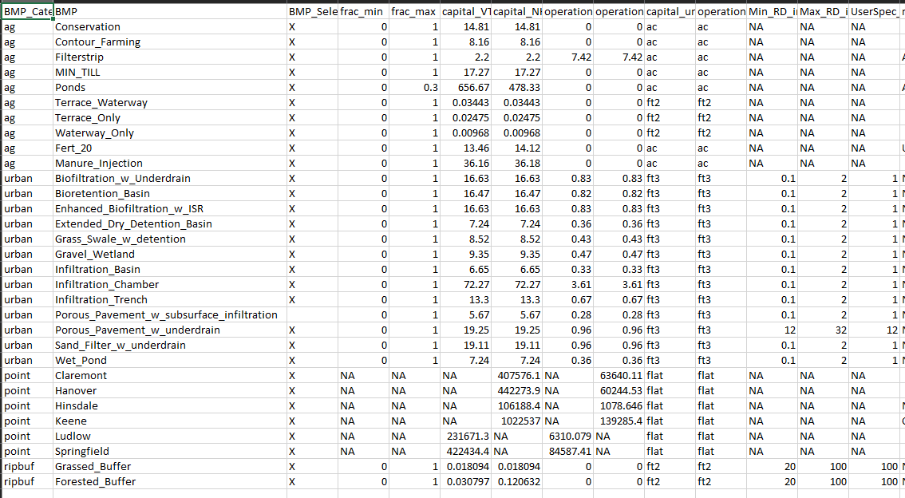
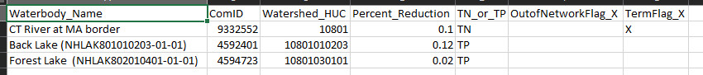
Data and user-specifications are input as csv files
Using R and Shiny for a clean user interface
12

Slide 13


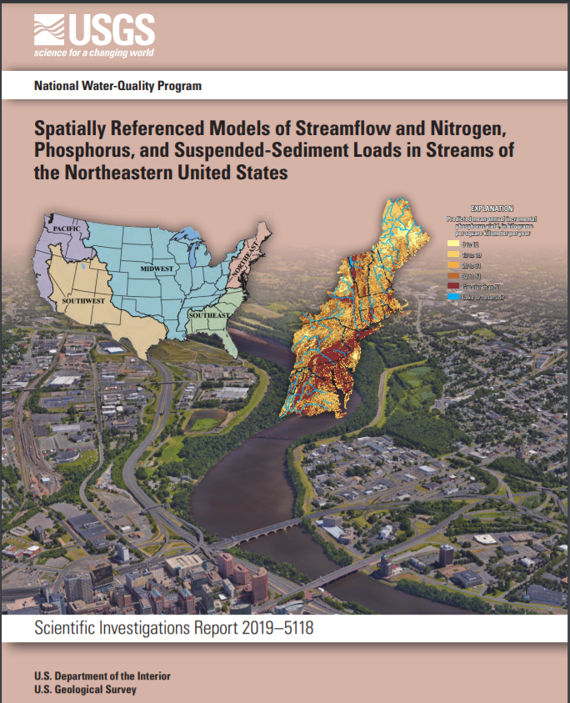
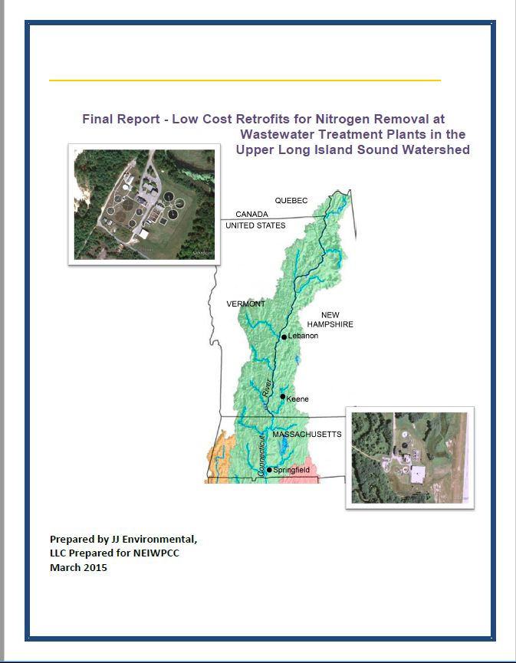

Data inputs are varied:
Software structure of the tool
& many many others
13

Slide 14
Use R to write AMPL:
User specified BMP specs (csv)
User specified loading targets (csv)
Landcover Data
Nutrient Removal Efficiency Data
2012 Regional SPARROW model
Cost Data
Preprocessor
Legend:
Data
Optimization Support File
User Input/Interaction
Result
Model
AMPL Data File
AMPL Model File
AMPL Command File
Optimization Solver
Best Management Practice (BMP) selection at minimized cost
Software structure of the tool
14

Slide 15
Use R and Shiny to view results and generate output data:
User specified BMP specs (csv)
User specified loading targets (csv)
Landcover Data
Nutrient Removal Efficiency Data
2012 Regional SPARROW model
Cost Data
Preprocessor
Legend:
Data
Optimization Support File
User Input/Interaction
Result
Model
AMPL Data File
AMPL Model File
AMPL Command File
Optimization Solver
Best Management Practice (BMP) selection at minimized cost
Postprocessor
Summary Report
CSV files of BMP implementation in each catchment
Software structure of the tool
15

Slide 16
Tool distribution
www.GitHub.com/USEPA/RBEROST
Software structure of the tool
16

Slide 17
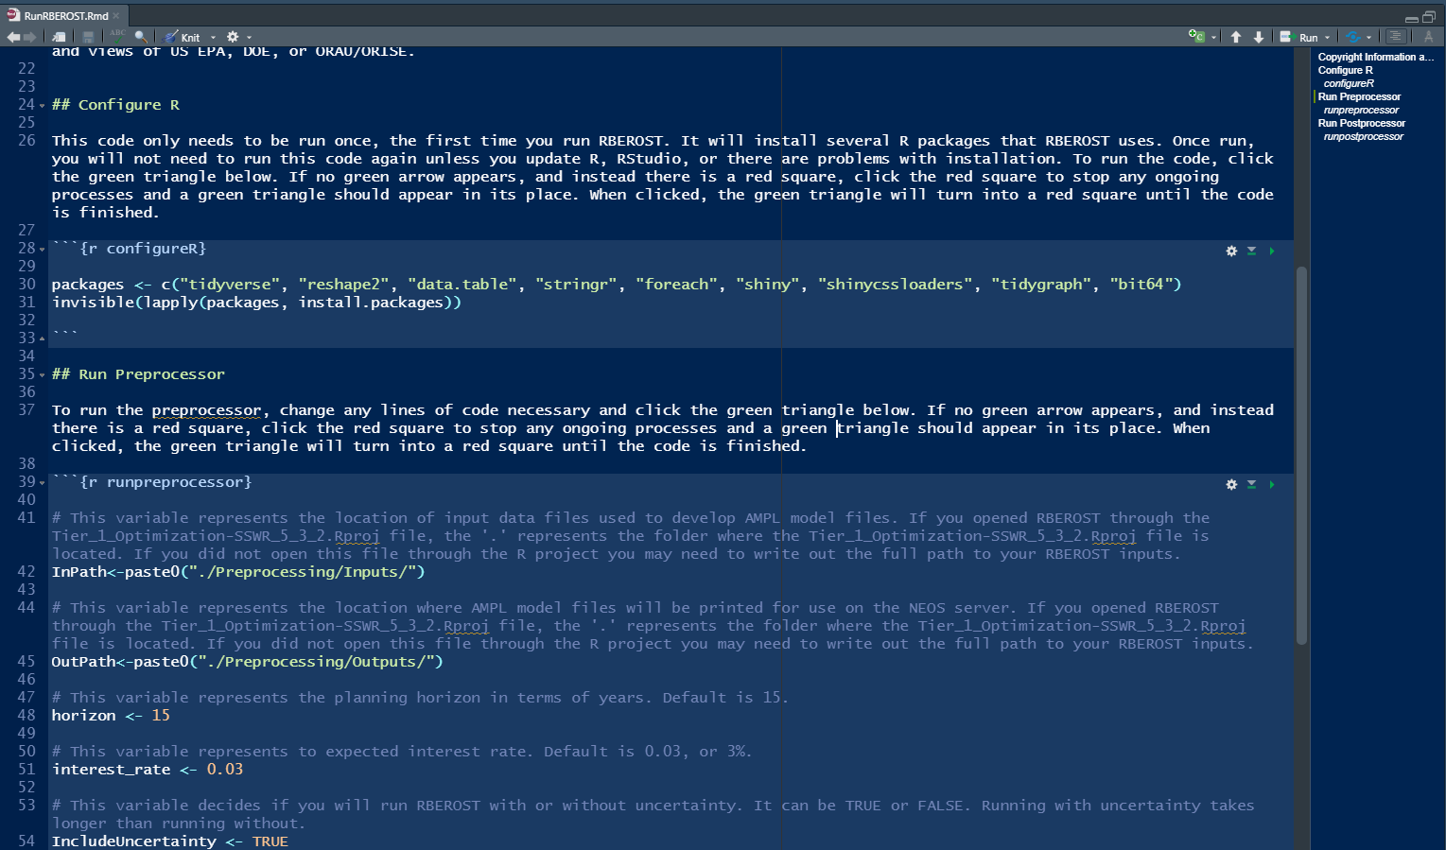
All* steps of the tool are presented to the user with minimal code interaction:
RMarkdown file with 3 code chunks
configureR (installs all necessary packages)
runpreprocessor (takes a few user inputs and sources necessary code to write the AMPL files)
runpostprocessor (launches the Shiny app to view results)
* Interaction with the server still requires users to navigate web submission forms on their own
Using R and Shiny for a clean user interface
17

Slide 18
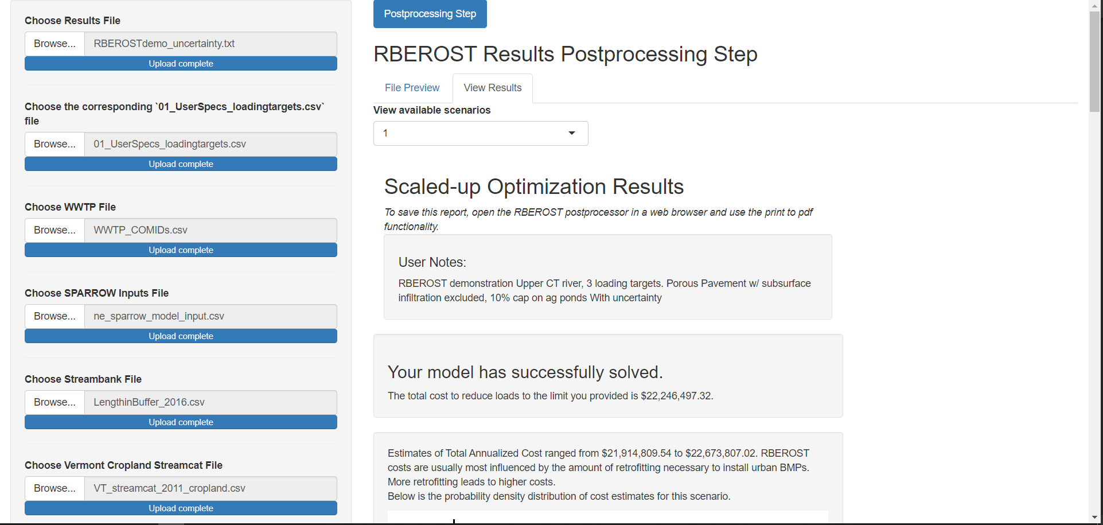
Shiny postprocessor:
Using R and Shiny for a clean user interface
18

Slide 19
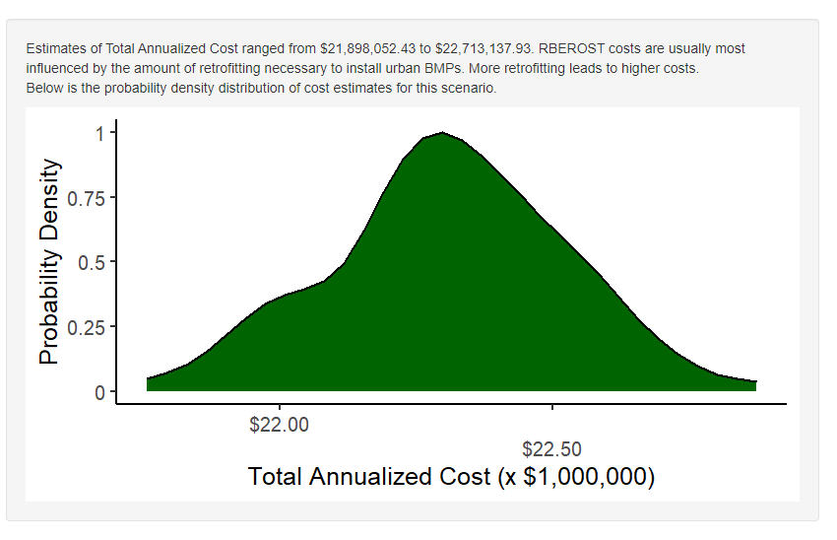
Shiny postprocessor:
Using R and Shiny for a clean user interface
19

Slide 20
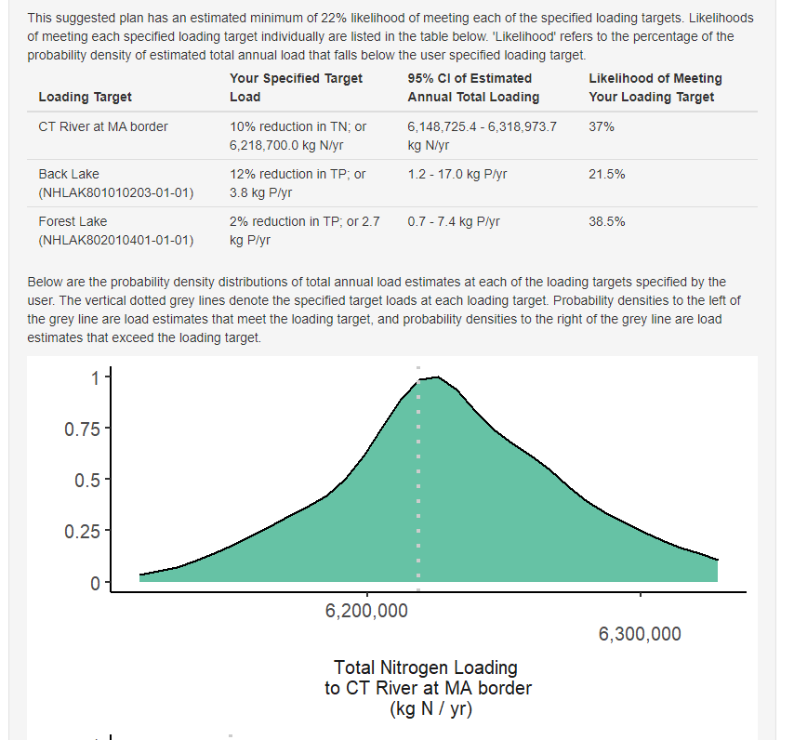
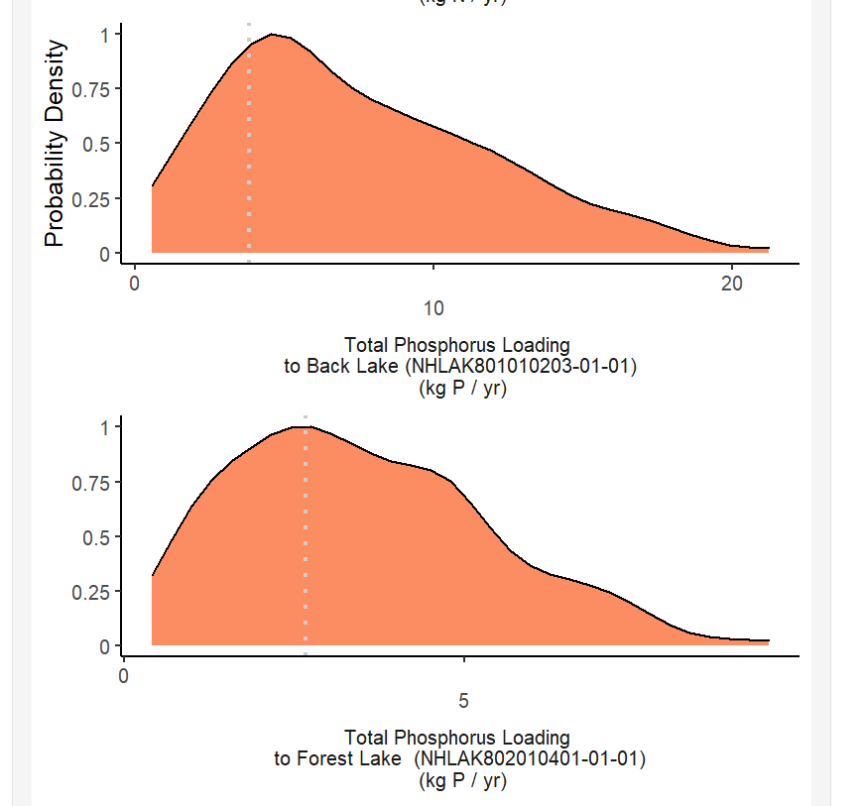
Shiny postprocessor:
Using R and Shiny for a clean user interface
20

Slide 21
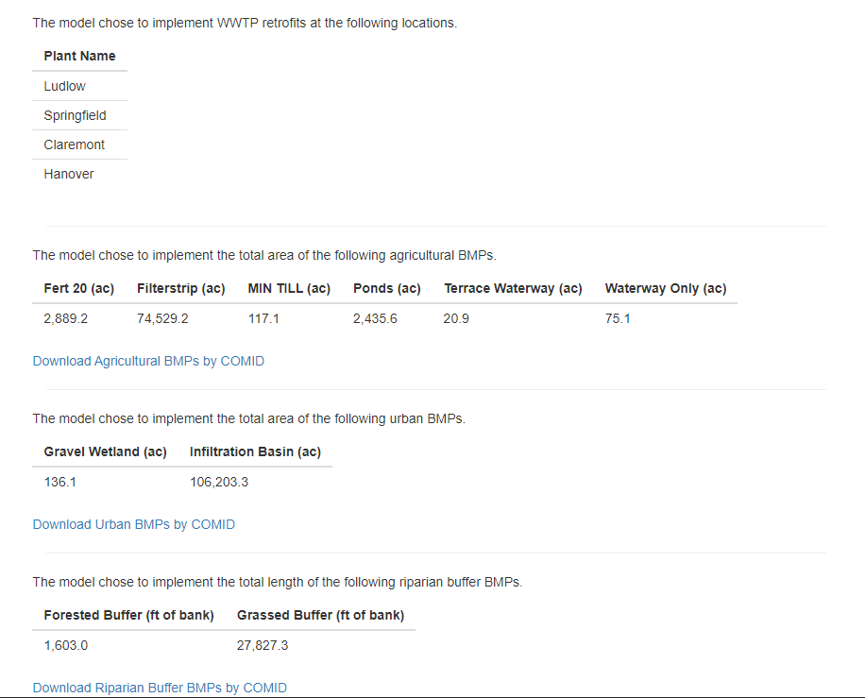
Shiny postprocessor:
Using R and Shiny for a clean user interface
21

Slide 22
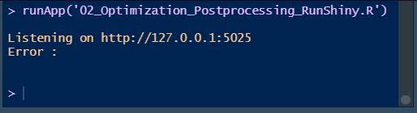
Lessons Learned:
Debugging Shiny != debugging R
Frequent use of browser() function for debugging
Printing out basic interactive statistics to the R console (not the Shiny window) can be immensely helpful for tracking reactivity
Sourcing User Interface files/functions is an easy way to maintain Shiny app organization
Sourcing server functions is less straight forward – must move the bulk of code to functions and source the functions that are then called within reactive code sections
Basic functions (e.g. read.csv()) may behave differently in different versions of R.
Code needs to be tested on multiple versions of R to be robust.
Code distribution mechanism matters!
Consider how code will be distributed as soon as possible in the planning process.
There are likely many workable in-betweens if the ideal delivery mechanism has challenges.
Lessons Learned
22

Slide 23
Future Directions:
Work the preprocessing step and the online server interaction into the Shiny app to further reduce interaction with source code.
Made data available for users online and provide an option to source this data through the tool. This reduces interaction with many csv files.
Expand the geographic range of available data to the entire northeast. Current version of RBEROST can be used anywhere within the northeast domain of the USGS regional SPARROW model.
Providing flexibility for RBEROST to be used in the Pacific regional SPARROW model area as well.
Future Directions
23

Slide 24






Thanks for Listening!
Emails:
chamberlin.catherine@epa.gov
Detenbeck.Naomi@epa.gov
24

